Slide 1
Physical Layer
Physical layer in the OSI model plays the role of interacting with actual hardware and signaling mechanism. Physical layer is the only layer of OSI network model which actually deals with the physical connectivity of two different stations. This layer defines the hardware equipment, cabling, wiring, frequencies, pulses used to represent binary signals etc.
Physical layer provides its services to Data-link layer. Data-link layer hands over frames to physical layer. Physical layer converts them to electrical pulses, which represent binary data. The binary data is then sent over the wired or wireless media.
Signals
When data is sent over physical medium, it needs to be first converted into electromagnetic signals. Data itself can be analog such as human voice, or digital such as file on the disk. Both analog and digital data can be represented in digital or analog signals.
Digital Signals
Digital signals are discrete in nature and represent sequence of voltage pulses. Digital signals are used within the circuitry of a computer system.
Analog Signals
Analog signals are in continuous wave form in nature and represented by continuous electromagnetic waves.

Slide 2
This layer plays with most of the network’s physical connections—wireless transmission, cabling, cabling standards and types, connectors and types, network interface cards, and more —as per network requirements.
Functions of Physical Layer
Following are the various functions performed by the Physical layer of the OSI model.
Representation of Bits: Data in this layer consists of stream of bits. The bits must be encoded into signals for transmission. It defines the type of encoding i.e. how 0's and 1's are changed to signal.
Data Rate: This layer defines the rate of transmission which is the number of bits per second.
Synchronization: It deals with the synchronization of the transmitter and receiver. The sender and receiver are synchronized at bit level.
Interface: The physical layer defines the transmission interface between devices and transmission medium.
Line Configuration: This layer connects devices with the medium: Point to Point configuration and Multipoint configuration.
Topologies: Devices must be connected using the following topologies: Mesh, Star, Ring and Bus.
Transmission Modes: Physical Layer defines the direction of transmission between two devices: Simplex, Half Duplex, Full Duplex.
Deals with baseband and broadband transmission.

Slide 3
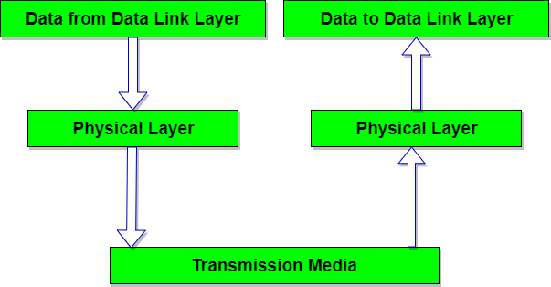
Examples of protocols that use physical layers include:
Digital Subscriber Line(Users get a high speed bandwidth connection from a phone wall jack on an existing telephone network.)
Integrated Services Digital Network(ISDN) is a set of communication standards for simultaneous digital transmission of voice, video, data, and other network services over the traditional circuits of the public switched telephone network.
Infrared Data Association(industry standard for wireless communication with infrared light.)
Universal Serial Bus (USB.)
Bluetooth.
Controller Area Network(Controller Area Network (CAN) is a serial network technology that was originally designed for the automotive industry, especially for European cars, but has also become a popular bus in industrial automation as well as other applications.)
Ethernet.

Slide 4
Basic hardware components used in the OSI physical layer include network interface cards (NICs), connectors and interfaces, and cables that facilitate the transmission of data from source to destination.
The Network Interface Card is a component installed in a computer in order to connect it to any available network. Connectors and Interfaces are used to connect cables from one source to another. Depending upon the type of cable used, connectors are chosen accordingly. Cables are physical components that carry electromagnetic or optic signals through them and transmit them from a network source to a network destination.

